Slide 1
E-commerce
Kevin Ramos, Stanley Ren, Jason Lyan

Slide 2
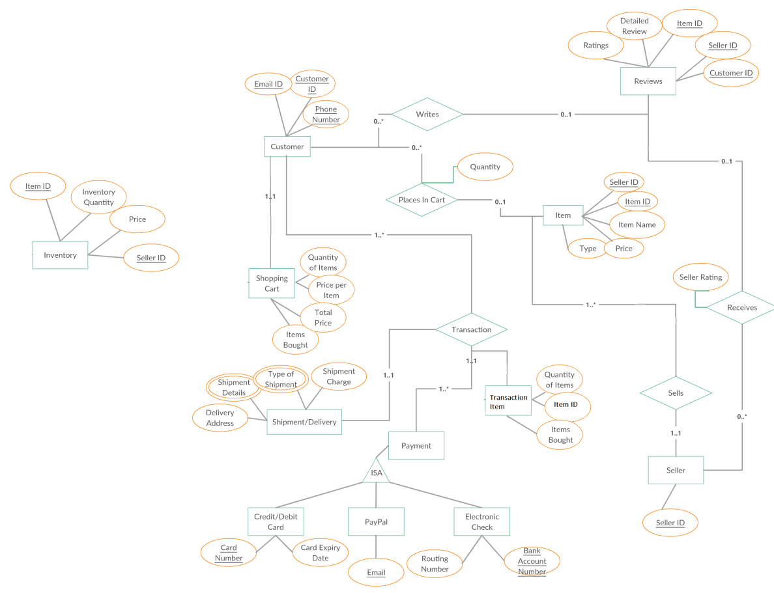
ER
Diagram

Slide 3
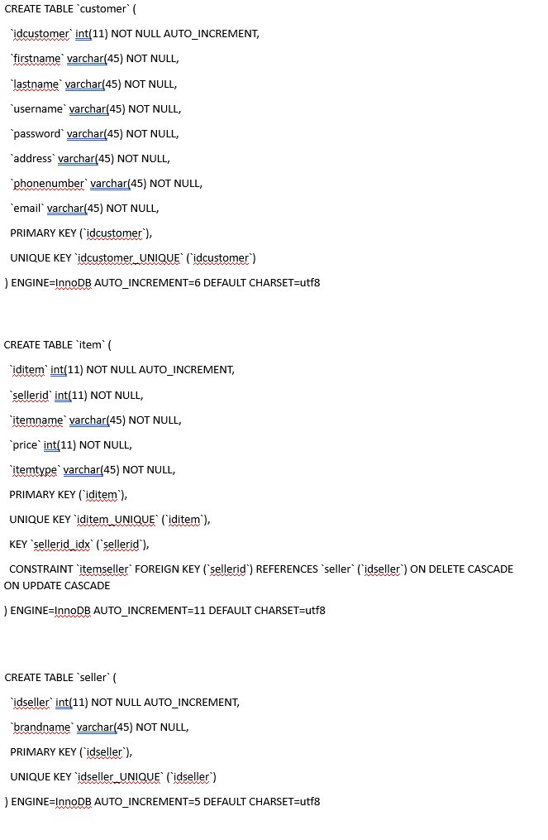
ER Mapping
Tables customer, seller, and item mapped in relation to the ER diagram
Primary Key constraint given for each table (IDs are necessary to uniquely identify these entities)

Slide 4
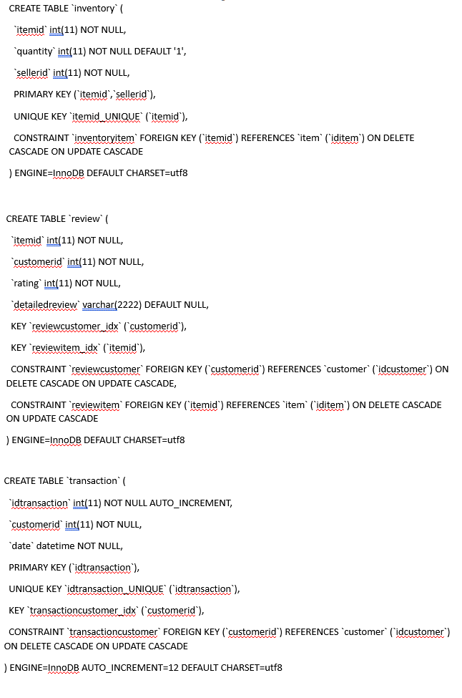
ER Mapping
Tables inventory, review, and transaction mapped in relation to the ER diagram
The transaction table is important because it details every purchase made in the e-commerce, linking the customerid and idtransaction together for reference to the transaction

Slide 5
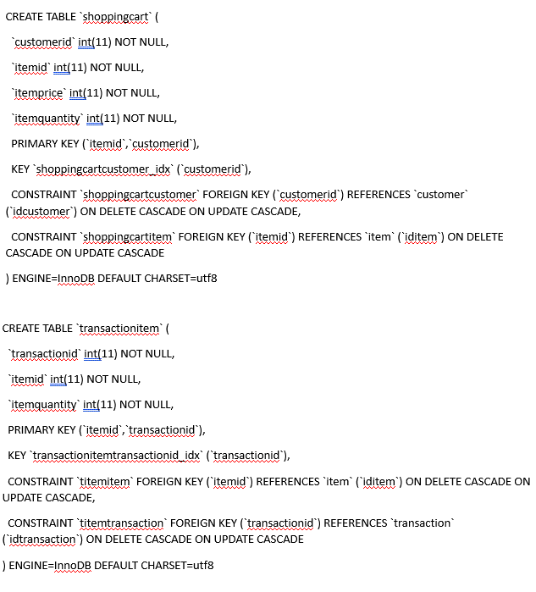
ER Mapping
Tables shoppingcart and transactionitem mapped in relation to the ER diagram
The transactionitem table is important because this is what will reference the list of items purchased in the transaction (referenced by ID)

Slide 6
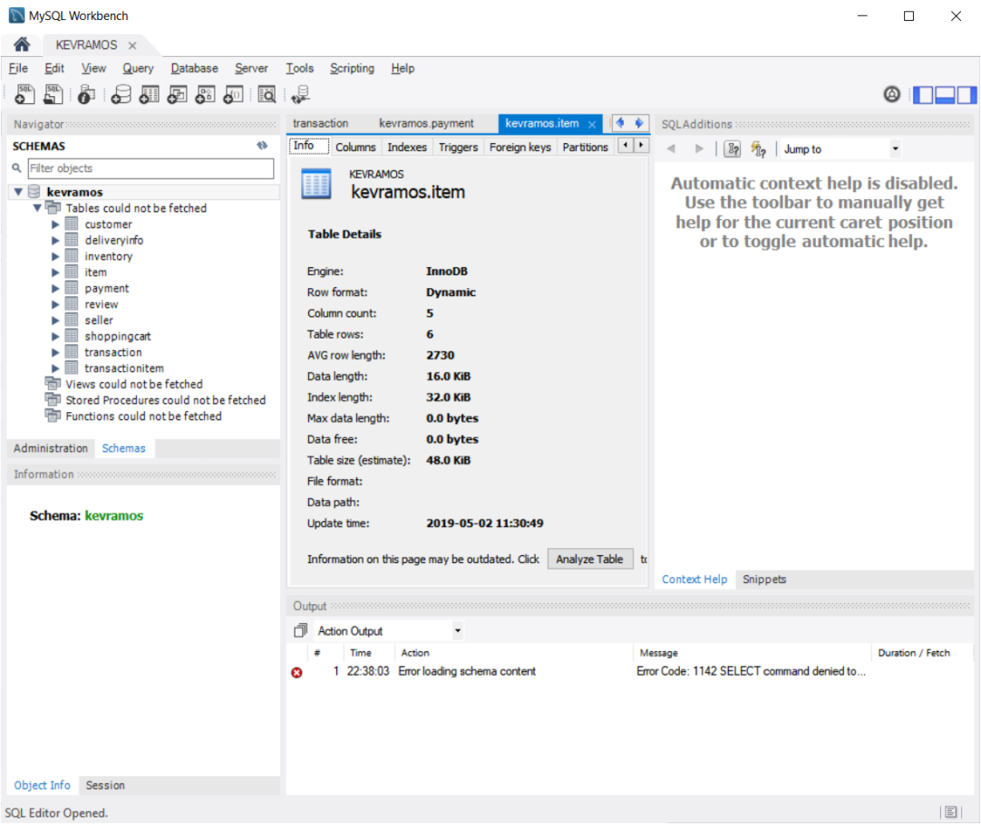
ER Mapping...
The rest of the tables are done in accordance to the design of the ER diagram, and their constraints are detailed in the documentation.
The demonstration will show the mapping in action

Slide 7
Contributions
Kevin Ramos – Laid the foundations for each part of the project, created tables and SQL statements, essentially the
fire-starter
Stanley Ren – Implemented the crux of the source code for Java(FX) and linked SQL together for the functionality of the transactions
Jason Lyan – Created presentation and criticized all major or minor flaws in the making, tweaking constraints and design flaws for improvement
*All other aspects of the project were done as a collaborative effort, each member pitching in their effort for its completion

